Slide 1
ECE 788
Automated Timetabling System Using Genetic Algorithms
Presented by – Sairam Gupta Padakanti
MS in Computer Engineering
UCID – Sp2977@njit.edu
STUDENT ID – 31620736

Slide 2
Problem statement
Making a class schedule is one of those NP hard problems. The problem can be solved using a heuristic search algorithm to find the optimal solution, but it only works for simple cases. For more complex inputs and requirements, finding a considerably good solution can take a while, or it may be impossible. This is where genetic algorithms come into the game

Slide 3

Introduction
Efficient scheduling is the heartbeat of any educational institution, and manual timetabling processes often fall short in meeting the increasing complexities of today's academic environments. Enter the Automated Timetabling System using Genetic Algorithms, A cutting edge solution that leverages evolutionary principles to optimize and streamline the scheduling process.

Slide 4
Challenges Addressed by Automated Timetabling
Addressing Complexities: Vast Search Space: Exploring numerous combinations for course schedules Constraints Management: Balancing various constraints such as room availability, faculty preferences and student courses.
Optimization Efficiency: Achieving optimal schedules efficiently
Advantages of Automation: Time Efficiency: Rapidly generating schedules without manual effort Conflict Resolution: Minimizing scheduling conflicts and optimizing resource utilization Adaptability: Handling dynamic changes in course offerings or resource availability

Slide 5
Genetic Algorithms
Genetic Algorithms (GAs) simulate the process of natural selection to solve optimization problems. They operate on the principles of evolution by iteratively improving a population of potential solutions to find an optimal or near-optimal solution. In the context of timetabling, GAs are well-suited for addressing the complexities involved in generating optimal schedules due to their inherent characteristics:
Iterative Improvement
Solution Representation
Fitness Evaluation
Adaptability and Diversity
Constraint Handling
Scalability and Efficiency
Global Search Capability

Slide 6
Additional Changes
Hyper parameter Tuning:
Implemented a thorough hyperparameter tuning process to fine-tune the algorithm's parameters. This involved systematically adjusting various hyper parameters to achieve optimal performance. The results indicate improved convergence and efficiency in generating high-quality
Constraints Integration:
To address specific scheduling constraints, incorporated a more robust constraint-handling mechanism. This ensures that the generated timetables adhere to all relevant constraints, leading to more practical and feasible solutions.

Slide 7
Changes
Optimization Steps Visualization:
added a visualization component to the optimization process. This feature allows for a step-by-step representation of the algorithm's progression, facilitating a better understanding of how the timetable is optimized over iterations
Randomization of Timetable Generation:
Recognizing the importance of diversity in timetable solutions, introduced a randomized element to the timetable generation process. This randomness enhances exploration of the solution space, preventing the algorithm from converging to suboptimal solutions prematurely.

Slide 8
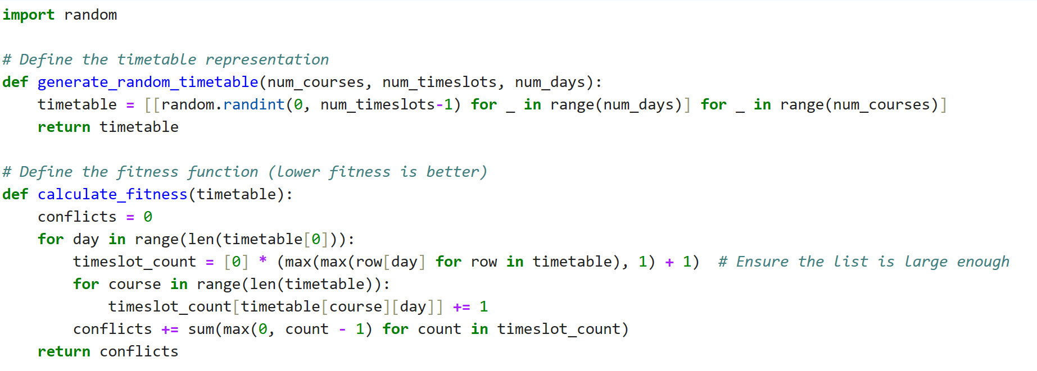
Code Explanation and Algorithm Breakdown
Generate_random_timetable: Purpose: Creates an initial random timetable layout. Functionality: Generates a timetable matrix assigning random timeslots to courses for a given number of days.
Calculate_Fitness: Purpose: Evaluates the fitness or quality of a timetable. Functionality: Counts conflicts arising from overlapping course schedules, helping to measure the timetable's quality.

Slide 9
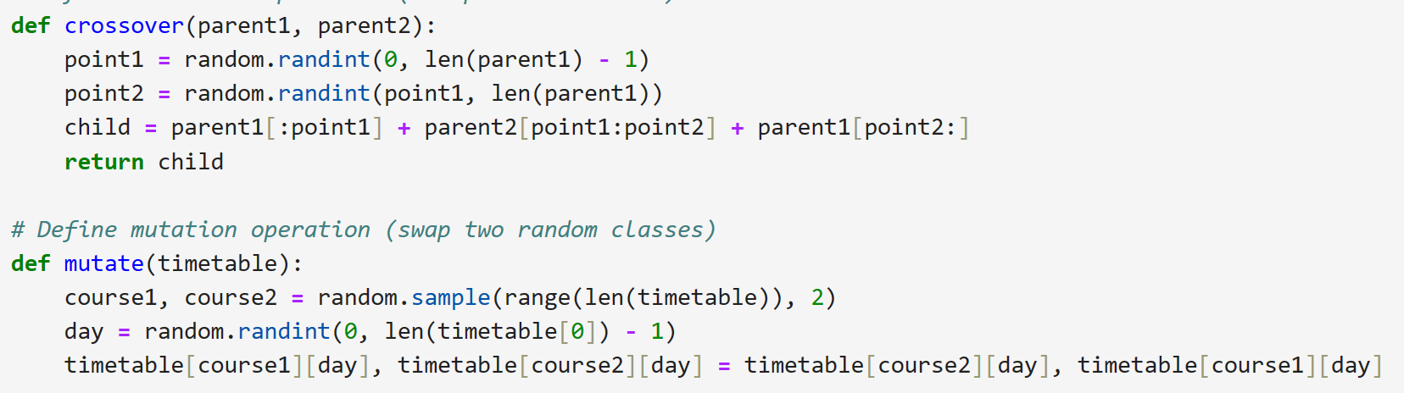
Crossover: Purpose: Creates offspring from parent timetables. Functionality: Combines two parent timetables at random points to produce new timetables, mimicking genetic crossover.
Mutate: Purpose: Introduces diversity by altering timetables. Functionality: Swaps courses between two random days, enhancing diversity in the population of timetables.

Slide 10
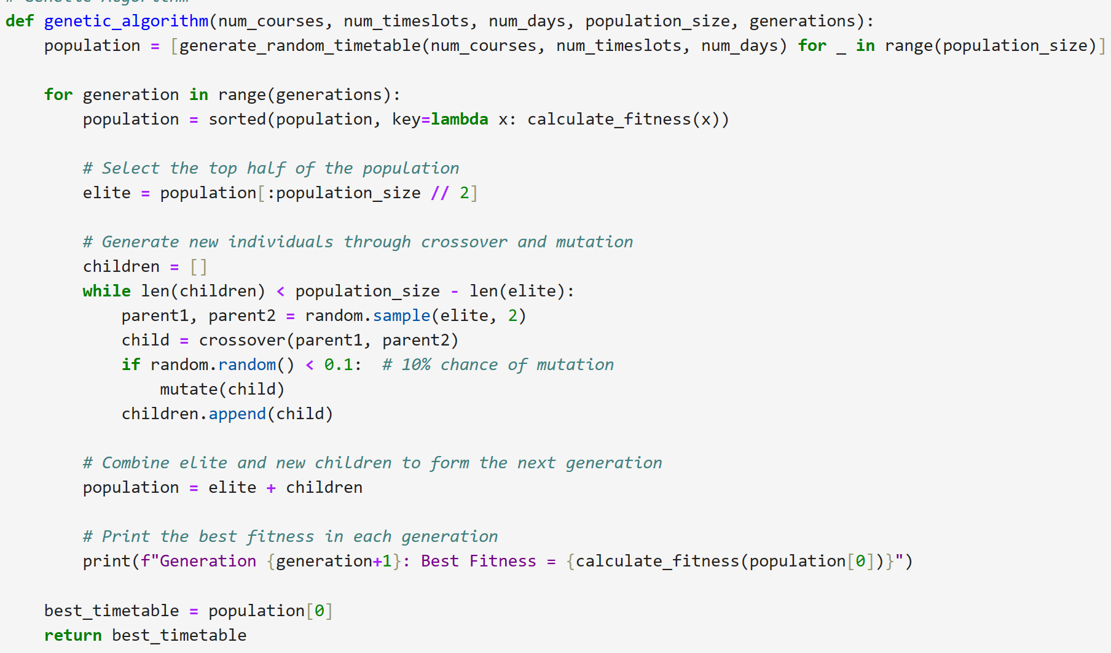
Genetic_algorithm: Purpose: Drives the genetic algorithmic process. Functionality: Orchestrates the evolution of timetables through generations, combining selection, crossover, and mutation to improve solutions iteratively.

Slide 11
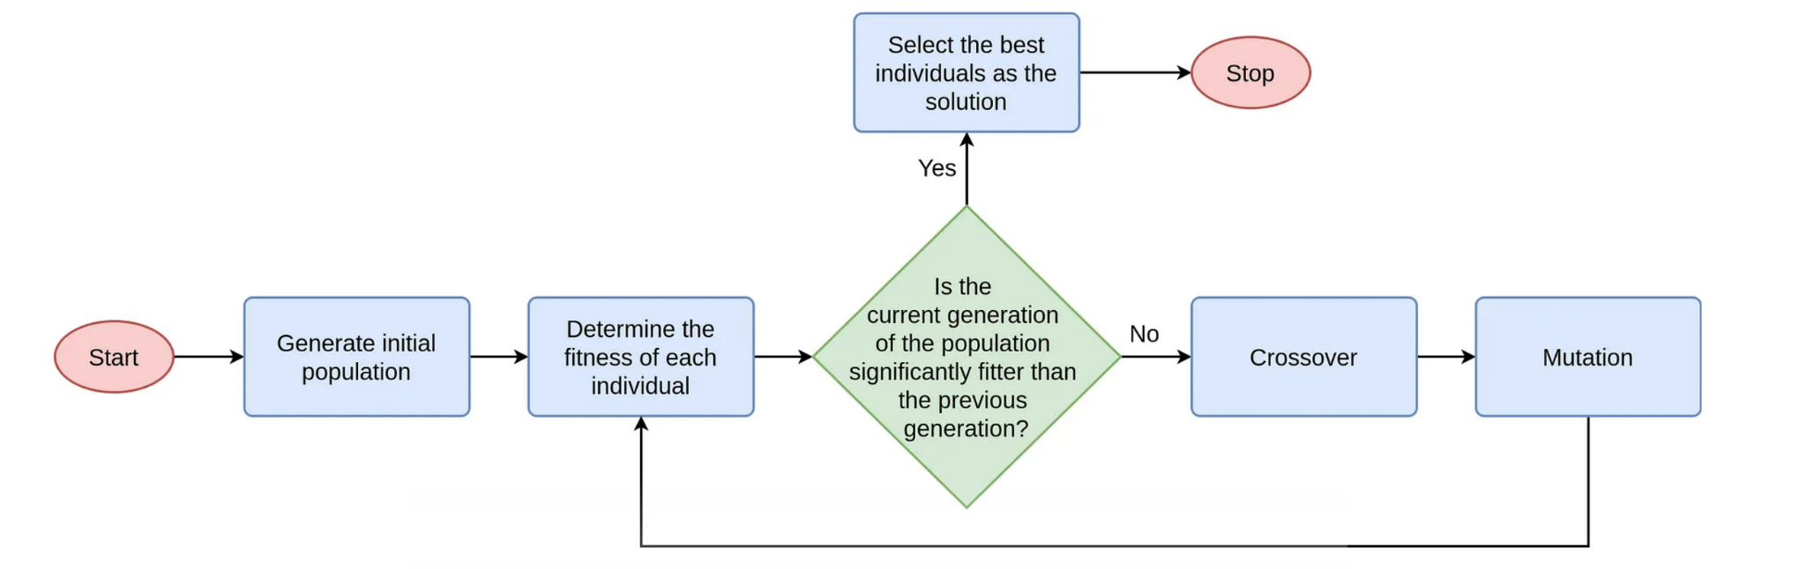
Genetic Algorithm Workflow
Initialization: Generate an initial population of random timetables
Fitness calculation: Assess each timetable’s fitness using the ‘calculate_fitness’ function to determine its quality based on constraints and conflicts
Crossover and mutation: Combine genetic information from selected parents using ‘crossover’ function to create new timetables(offspring) Mutation Operation: Introduce diversity by applying the ‘mutate’ function to alter some timetables within the population
Next Population Formation: Combine elite timetables and newly created offspring to form the next generation

Slide 12
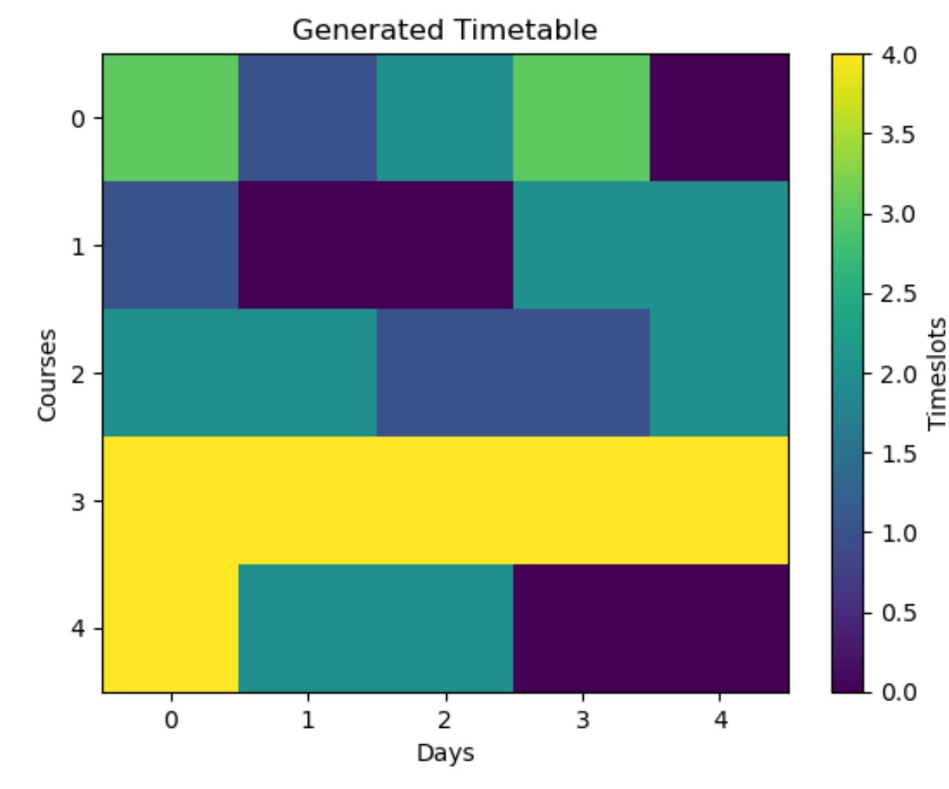
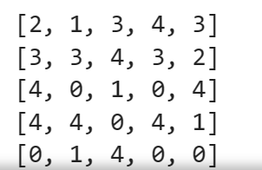
Genetic Algorithm Performance Visualization
.

Slide 13
Impact of Genetic Algorithms in Automated Timetabling
Benefits of Genetic Algorithms:
Optimization and Efficiency: Genetic Algorithms efficiently explore schedule possibilities, optimizing timetables for resource utilization and conflict reduction.
Constraint Management: Effectively handle diverse constraints like room availability, faculty preferences, and course scheduling, ensuring constraint satisfaction.
Adaptability and Dynamic Changes: Ability to adapt to dynamic changes in schedules, accommodating alterations without compromising the quality of schedules.
Quality Improvement Over Iterations: Iterative refinement leads to improved timetable quality with each generation, aiming for near-optimal solutions.
Impact on Educational Institutions: Enhanced Resource Utilization: Optimal allocation of resources including rooms, faculties, and time slots, maximizing utilization.
Adaptation to Preferences: Consideration of student and faculty preferences, contributing to a more satisfactory learning and teaching experience.
Efficiency Gains: Reduced time and effort in schedule generation, allowing staff to focus on other critical tasks, ultimately improving overall productivity.

Slide 14
Summary
Key Takeaways:
Efficiency through Automation: Automated timetabling using Genetic Algorithms optimizes schedules efficiently, reducing conflicts and enhancing resource utilization.
Adaptability and Flexibility: The algorithm's adaptability caters to dynamic changes, ensuring schedules accommodate alterations without compromising quality.
Benefits for Educational Institutions: Improved resource allocation, student-faculty preference accommodation, and reduced workload for staff, leading to increased productivity.

Slide 15
Conclusion, Takeaway and Changes-
This project has enabled me to a better understanding on genetic algorithm and its working flow.
Exposure to python programming dealing with different libraries.
Automated timetabling employing Genetic Algorithms revolutionizes the scheduling process for educational institutions. It not only streamlines the creation of optimized schedules but also brings adaptability and efficiency into play, catering to the diverse needs of students and faculty. The algorithm's continuous improvement over iterations leads to near-optimal solutions, making it an invaluable tool for institutions seeking to optimize their schedules.

Slide 16
Thank you Refrences: https://github.com/pranavkhurana/Time-table-scheduler

